Slide 1
Multimodal Brain-State Classification Using EEG and MRI with Deep and Traditional Machine Learning Approaches. Presented By Md Mahmudul Hasan MSc. In Electrical and Computer Engineering Oklahoma State University

Slide 2
Outline
Motivation
Background
Dataset
Methodology
EEG Feature Extraction
MRI Feature Extraction
Fusion Techniques
Results
Discussion
Conclusion & Future work

Slide 3
Motivation
Age classification Brain structure and function change across the lifespan—being able to infer age from EEG/MRI helps us track healthy development and detect early signs of neurodegeneration.
Gender classification Subtle sex-related differences in brain anatomy and electrophysiology influence cognition and disease risk; identifying gender from brain data can improve model fairness and tailor interventions.
Sleep-state (Awake vs. Tired) classification Real-time detection of vigilance fluctuations is critical for fatigue management in transportation, military, and healthcare—early warning of tiredness can prevent accidents.
Enhanced discrimination Multimodal inputs allow finer separation between classes (e.g., younger vs. older, male vs. female, awake vs. tired), improving metrics like accuracy and AUC

Slide 4
Dataset
Cohort & Sessions(Lemon Dataset)
216 healthy adults (balanced young vs. older)
13 excluded for missing/low-quality data → 203 final participants
Two sessions per participant:
Session 1: MRI acquisition + cognitive assessments.
Session 2: Resting-state EEG + behavioral testing.

Slide 5
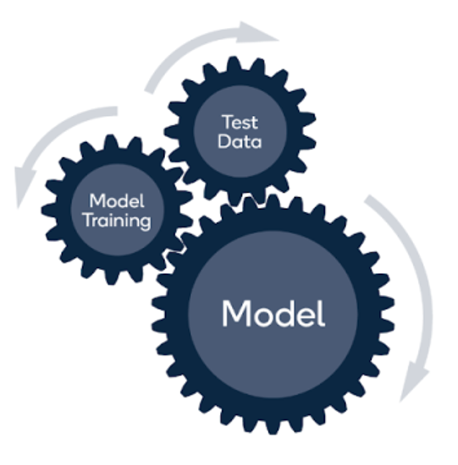





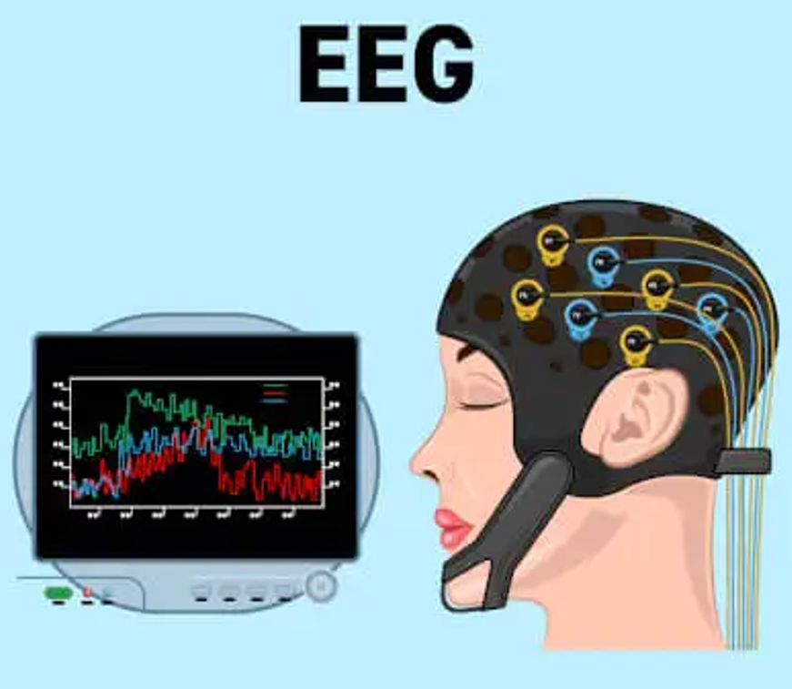
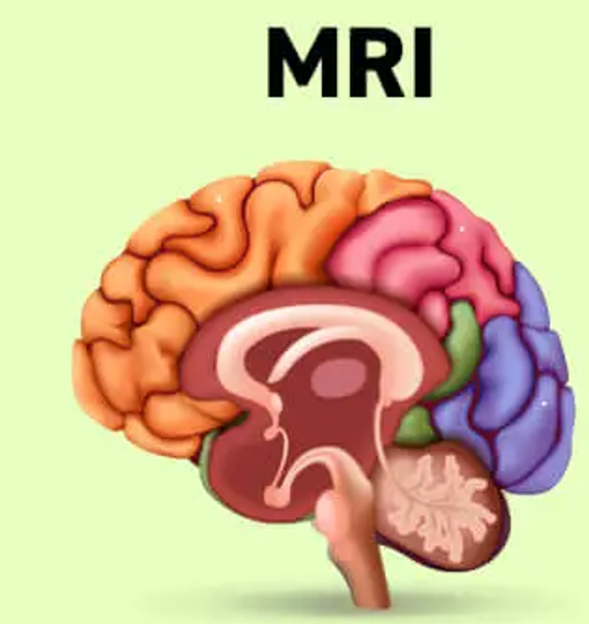
Methodology
Input
Preprocessing
Feature Extraction
Fusion
Model
Classification Results

Slide 6
EEG Feature Extraction
The Discrete Wavelet Transform (DWT) is a powerful signal-processing tool that decomposes a time-series into a hierarchy of frequency-localized components, enabling multiresolution analysis.
DWT uses compactly supported wavelet basis functions that are dilated (scaled) and translated (shifted) to capture both slow trends and fast transients.
Decompose each EEG channel signal into 6 subbands:
Approximation at level 5 (A₅).
Details at levels 1–5 (D₁, D₂, D₃, D₄, D₅).
Captures both low-frequency trends (A₅) and high-frequency transients (D₁–D₅).
Statistical Feature Computation: Mean, RMS, Variance, Kurtosis.
Scalogram Generation: Continuous Wavelet Scalogram Generation (224×224×17)
Uses Morlet (or chosen) wavelet to capture both transient and oscillatory features

Slide 7
MRI Feature Extraction
FreeSurfer‐Style Pipeline:
Skull‐stripping, tissue segmentation (gray/white matter), cortical surface reconstruction.
Generates vertex‐wise measures: cortical thickness, surface area, curvature.
ROI-Based Feature Derivation:
Use a standard cortical/subcortical atlas (e.g. Harvard–Oxford or Desikan–Killiany)
Extract regional metrics per ROI: Mean cortical thickness, Gray matter volume, Surface area.
Dimensionality Reduction via PCA:
Capture the majority of anatomical variability in fewer components
Adapting 3D MRI to Pretrained 2D CNN Inputs:
Original volume: 256 × 256 × 256 voxels per subject.
Pretrained model input: 224 × 224 × 3 .
Three orthogonal planes at volume center: Axial (Z = 128), Coronal (Y = 128), Sagittal (X = 128).
Captures complementary anatomical views in one “pseudo-RGB” image.

Slide 8
Data Fusion Techniques
Deep-Model Fusion:
Early Fusion: Raw inputs (scalogram & 3-slice image) → single network
Late Fusion: Modality embeddings (512-D each) → concatenate → MLP head.
DWT + FreeSurfer-Style (Late Fusion):
Level-5 wavelet decomposition → subband energies summarize δ–γ bands.
Surface reconstruction → cortical thickness, curvature, area per atlas ROI.
Merge wavelet-based EEG classifier with surface-metric MRI classifier.
FAWT + PCA (Late Fusion):
Fractional-Order Wavelet Transform (FAWT) →Captures subtle, fractal-like dynamics in EEG that traditional DWT might miss.
PCA → Reduce hundreds of regional volumes/thickness measures into a handful of orthogonal components.
Train independent classifiers on FAWT-derived EEG and PCA-reduced MRI features, then concatenate their outputs and pass them into a lightweight fusion classifier.

Slide 9
Deep Learning Architecture
Variants: ResNet-50, ResNet-101, ResNet-152 (ImageNet-pretrained)
Input Adaptation:
EEG scalograms → modify first conv to 3­­→17 channels (replicate RGB weights)
MRI slices → stack 3 orthogonal views into a 3­-channel 224×224 image.
Freeze: conv1, layer1, layer2, most BatchNorms. Unfreeze: layer3, layer4, BatchNorm layers in those blocks
Architecture: Vision Transformer (from CLIP)
Freeze: first L–4 encoder layers, Unfreeze: last 4 encoder layers + projection head
Optimizer: AdamW (lr=1e-4, weight_decay=1e-4)
Scheduler: ReduceLROnPlateau (factor=0.5, patience=5)
Batch size: 16 (EEG), 8 (MRI)

Slide 10
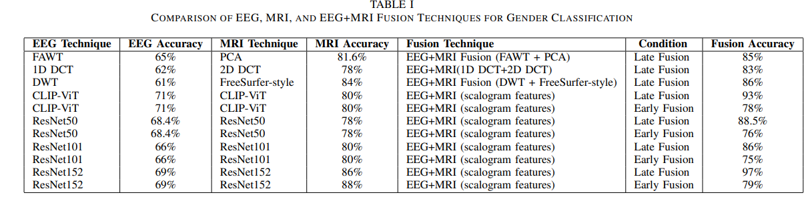
Experimental Results Gender Classification

Slide 11
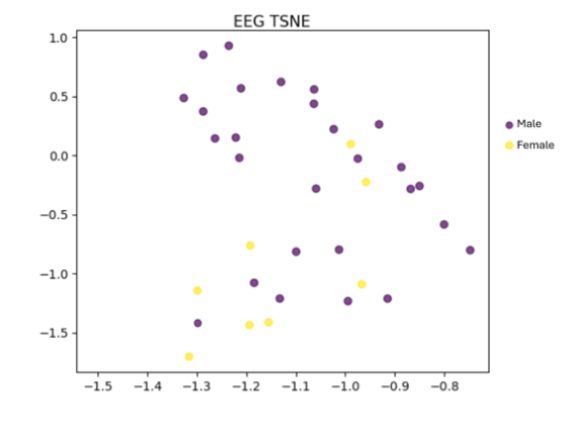
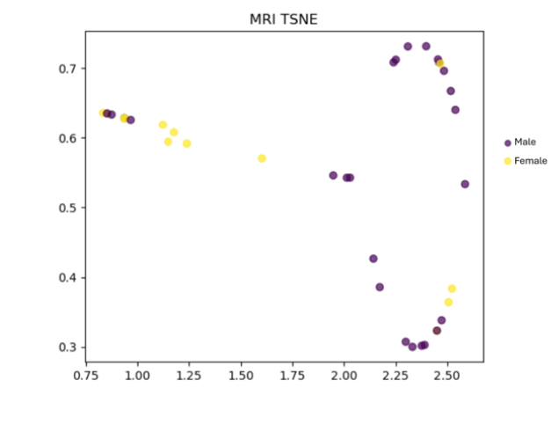
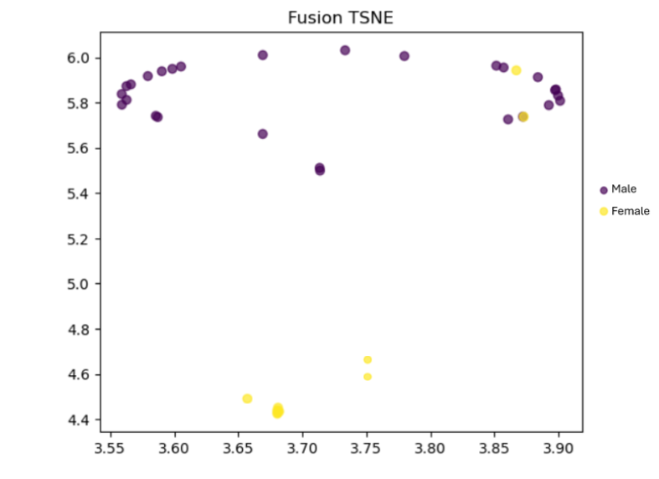
Experimental Results Gender Classification

Slide 12
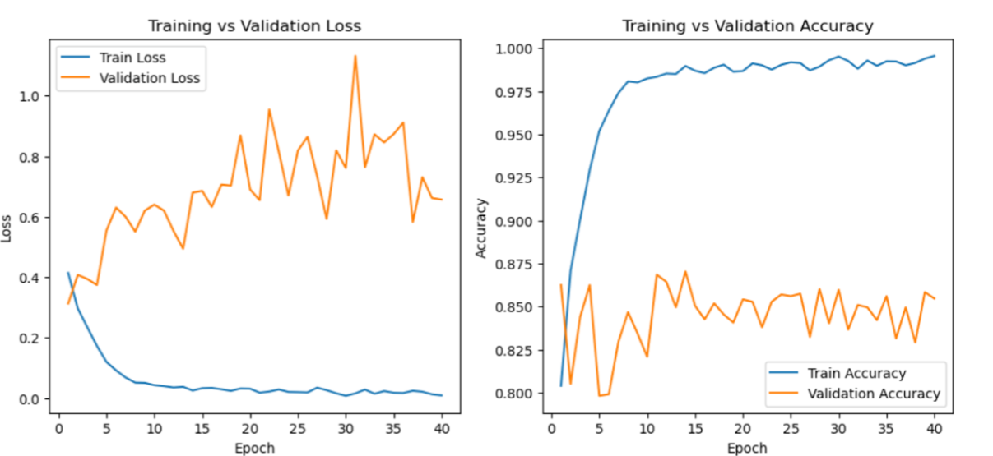
Gender Classification

Slide 13
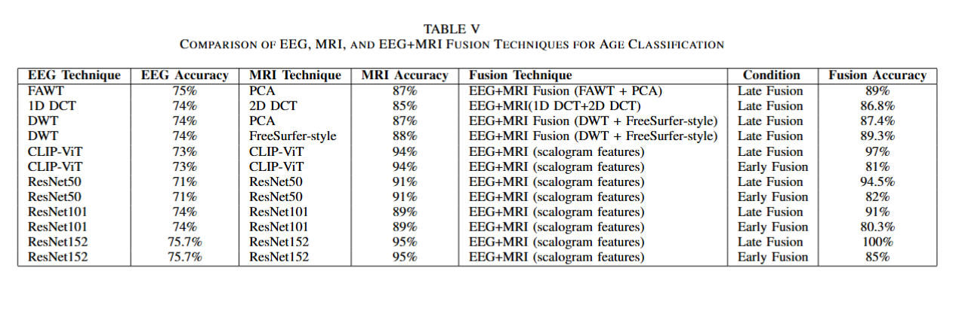
Experimental Results Age Group Classification

Slide 14
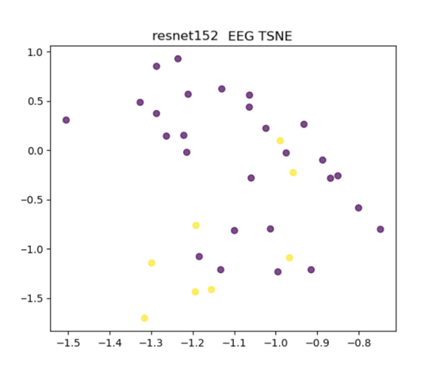
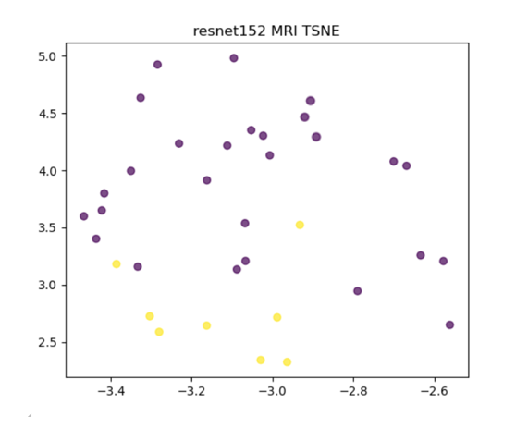
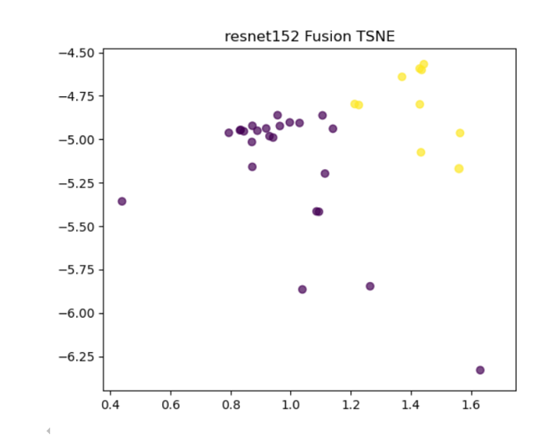
Experimental Results Age Group Classification

Slide 15
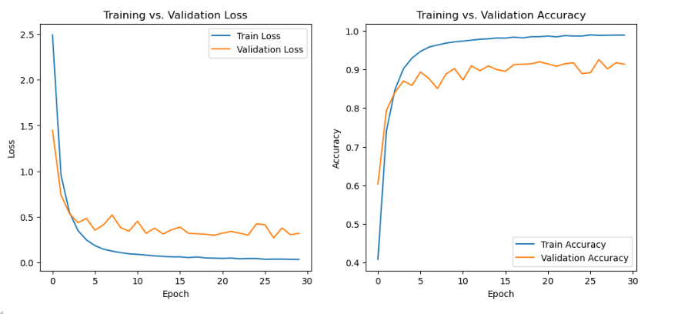
Age Group Classification

Slide 16
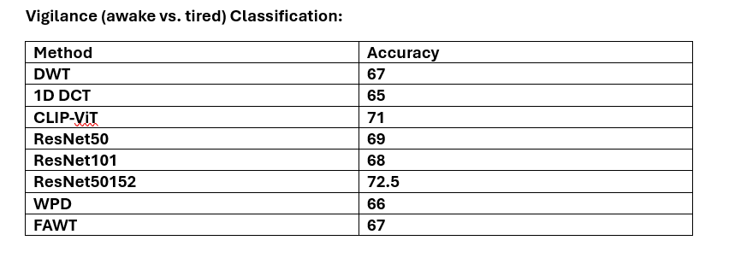
Experimental Results Vigilance State Classification (Awake-Tired)

Slide 17
Discussion
Fusion Superiority: Late fusion of EEG + MRI embeddings boosts accuracy across all tasks (e.g. gender: 71%/88% → 97%; age: 75.7%/95% → 100%; vigilance: 72.5% → ~80%).
Model Capacity: Deeper backbones (ResNet152, CLIP-ViT) yield richer features—fusion gains scale with network depth.
Fusion Strategy: Concatenating high-level embeddings outperforms early input fusion by preserving modality-specific processing.
EEG Limits: Vigilance remains challenging—higher recall for tired vs. awake suggests fatigue EEG signatures are more distinct than alertness.
Future Directions: Expand to larger/diverse cohorts, add temporal models (e.g. LSTM), incorporate more modalities (fNIRS, ECG), and improve model explainability.

Slide 18
Conclusion
Fusion Wins: Combining EEG’s temporal dynamics with MRI’s spatial detail via intermediate fusion consistently outperforms single‐modality models.
Top Performance: Achieved up to 100% accuracy for age‐group and 97% for gender classification; vigilance detection also improved notably.
Key Takeaway: Deep, multimodal embeddings unlock powerful, personalized brain‐state decoding—paving the way for next‐generation clinical and BCI applications.

Slide 19
Thank you

